Slide 1
Software Composition Analysis Deep Dive [slightly revised]
Ulisses Albuquerque, OWASP AppSec Day 2018
Application Security Consultant @ PS+C Group, Hobbyist Bitbanger

Slide 2
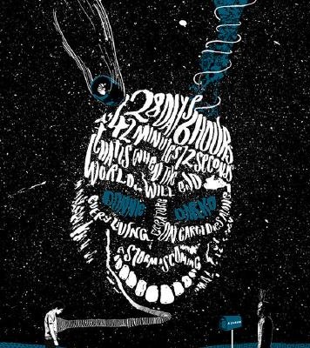
from legal import disclaimer
Opinions are my own, not my employer’s
Focus on Javascript/npm because its ecosystem exacerbates the effects of bad component management practices
Prone to swearing at times (sorry!)
Donnie Darko Queens Film Theatre

Slide 3
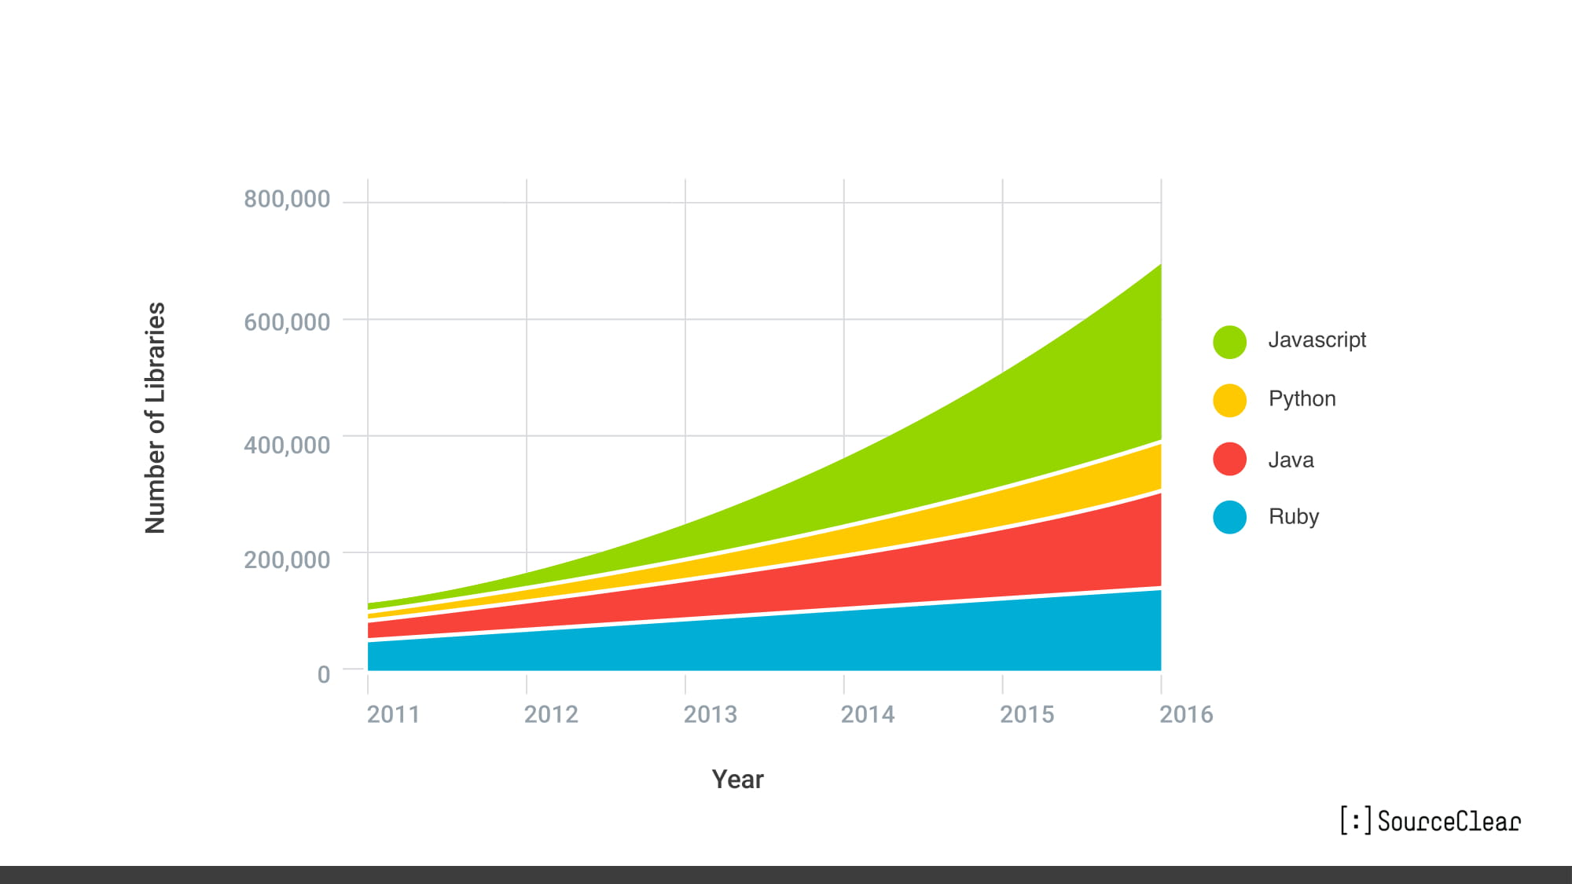
Findings Vulnerabilities and Malware in Open-Source Code at Scale
Notes:
This chart was blatantly copied from Mark Curphey’s keynote for Hack in Box; link to original slide deck included – please watch that, it is great to grasp the open source component space challenges

Slide 4
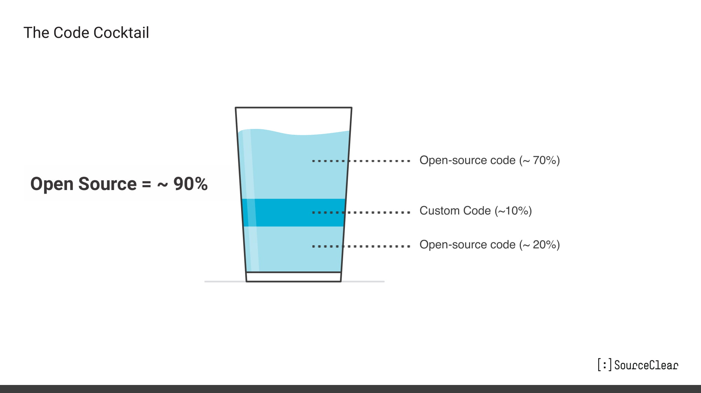
Findings Vulnerabilities and Malware in Open-Source Code at Scale
Notes:
Open source party code makes up to 90% of the code in modern applications, yet there is usually very little visibility outside of development teams on what goes in

Slide 5
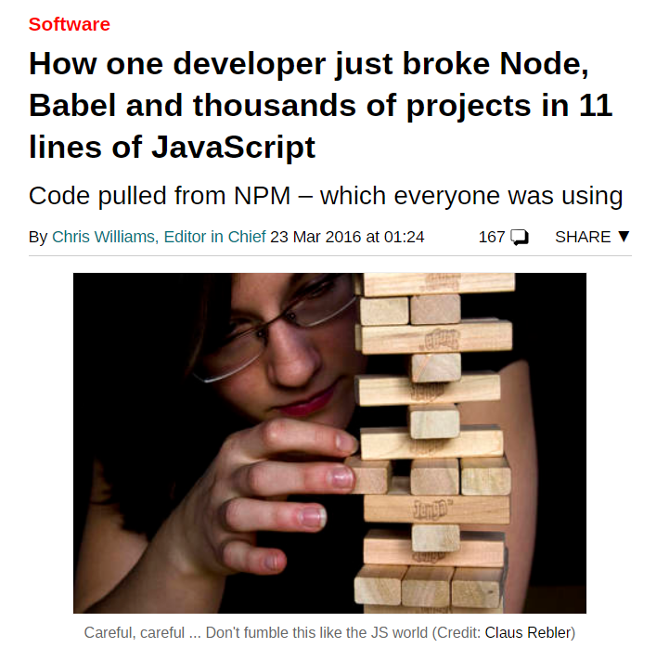
How one developer just broke Node, Babel and thousands of projects in 11 lines of JavaScript
Notes:
left-pad was removed because its developer received an order to change the name of one of his modules, kik; he refused, and the company reached out to npm claiming brand infringement; the developer became enraged and removed ALL of his published modules – more than 250 of them

Slide 6
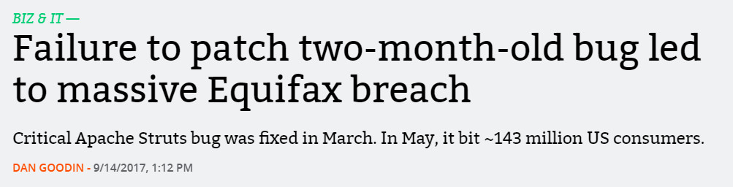
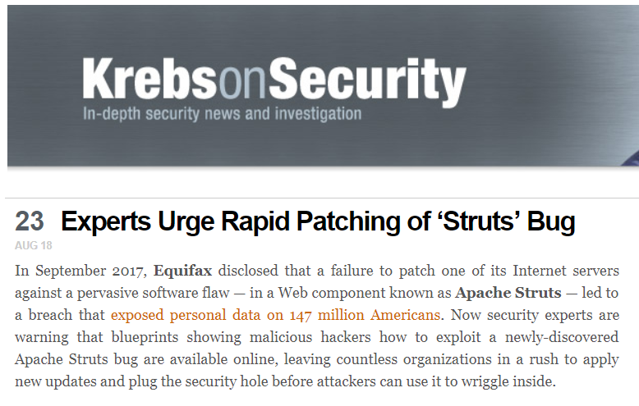
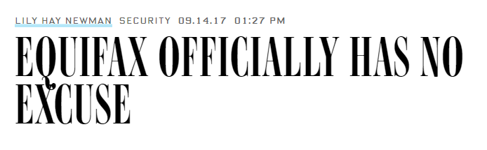
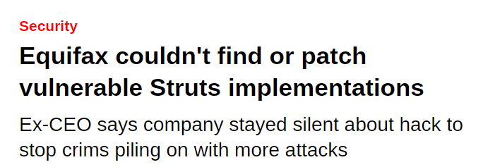
Notes:
Unless you were living under a rock in 2017, you heard about the Equifax breach; it even triggered an official response from the Apache Struts project; if you were at Nina’s talk you already header enough about this stuff

Slide 7

Equifax waited 5 weeks to admit it had doxed 44% of America, did nothing to help us while its execs sold stock
Notes:
Then Equifax happened, and the reason this is relevant to our story if because Equifax was breached through a vulnerable library, Apache Struts

Slide 8
On Aug. 22, the Apache Software Foundation released software updates to fix a critical vulnerability in Apache Struts, a Web application platform used by an estimated 65 percent of Fortune 100 companies. Unfortunately, computer code that can be used to exploit the bug has since been posted online, meaning bad guys now have precise instructions on how to break into vulnerable, unpatched servers.
Experts Urge Rapid Patching of ‘Struts’ Bug
Notes:
The vulnerability in question is CVE-2017-5638, and is quite trivial to exploit -- unfortunately

Slide 9
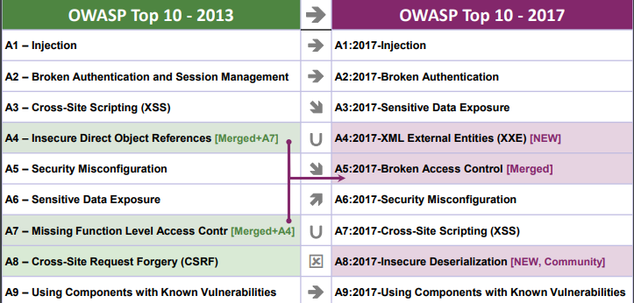
OWASP Top 10 2017
Notes:
OWASP has raised the risk involved in using vulnerable components for some time now

Slide 10

Visibility
How can we discover which components are being used in software in an organization?

Slide 11
Application Manifest
Vulnerability Data Sources
Dependency Metadata
Notes:
Obtaining visibility on vulnerable components is the first step; we do this by comparing application dependency manifests, artefacts and vulnerability data sources

Slide 12
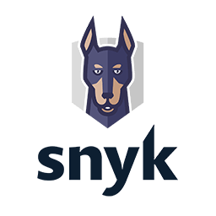
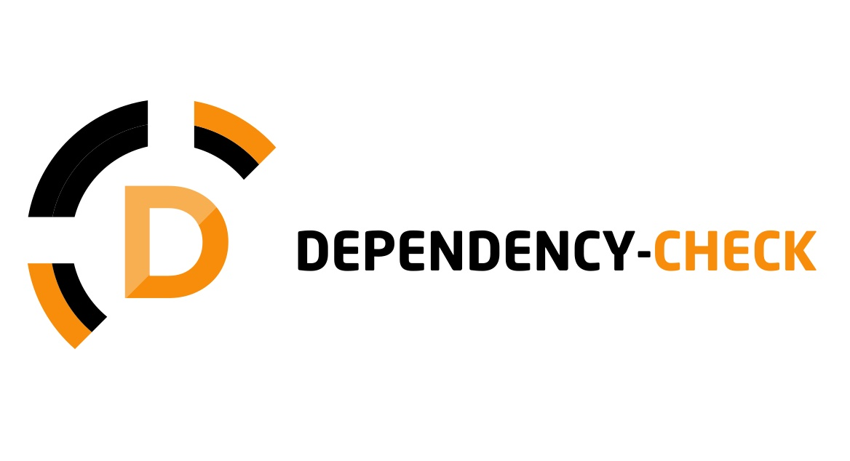


Key Players
Notes:
NOT AN EXHAUSTIVE LIST, but the stuff I have the most experience with; these tools are more focused on identifying vulnerabilities in applications via their manifest files/builds – we will talk about artefact registries later

Slide 13
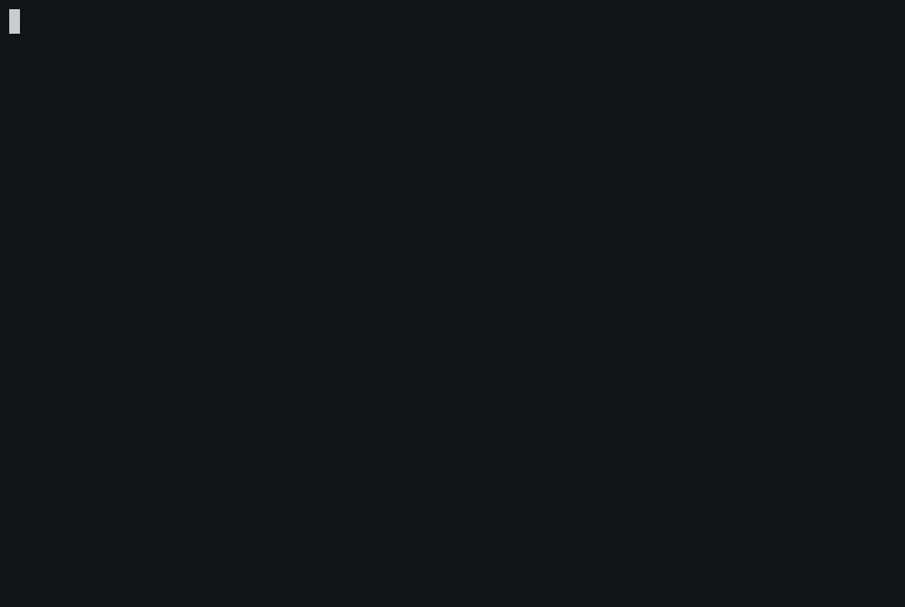
OWASP Dependency Check
Application: OWASP Juice Shop
Dependencies managed via node.js npm
Vulnerability data sources from NVD CVEs
Dependency Artefacts stored under node_modules
Notes:
OWASP Dependency Check scanning OWASP Juice Shop, report is output to files, not to screen, and aside from HTML is mostly meant for machine consumption; OWASP Dependency Check does not provide much advice in terms of remediation

Slide 14
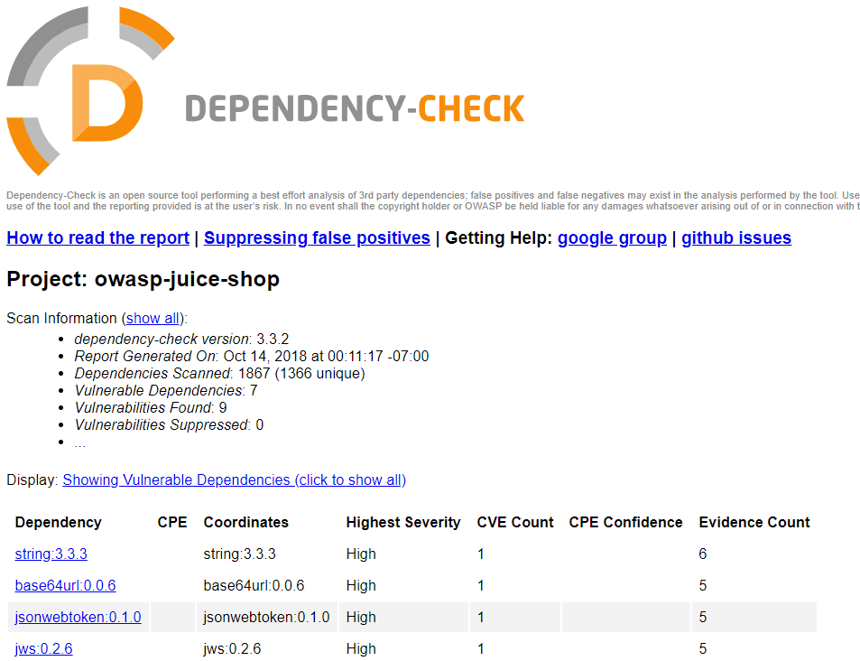
Reading the report
Dependencies scanned
Coordinates
Evidence count
Notes:
Lots of information here which might seem counter-intuitive at first sight; let’s start with the number of dependencies identified

Slide 15

Between runtime and development dependencies we have 110 libraries – where did the remaining 1757 came from?
Notes:
Dependencies in npm manifest files are stored as JSON documents inside package.json files; similar patterns exist for most dependency management solutions, such as Maven, Rubygems or pip – all manifest files are machine-parsable

Slide 16
Transitive/Indirect Dependencies
Dependencies are not a list, but rather a graph.
Direct dependencies listed in the application manifest have dependencies of their own, recursively.
Dependency resolution is typically resolved at build time.
Notes:
Introduce the idea of transitive dependencies, mentioning that libraries have dependencies of their own

Slide 17
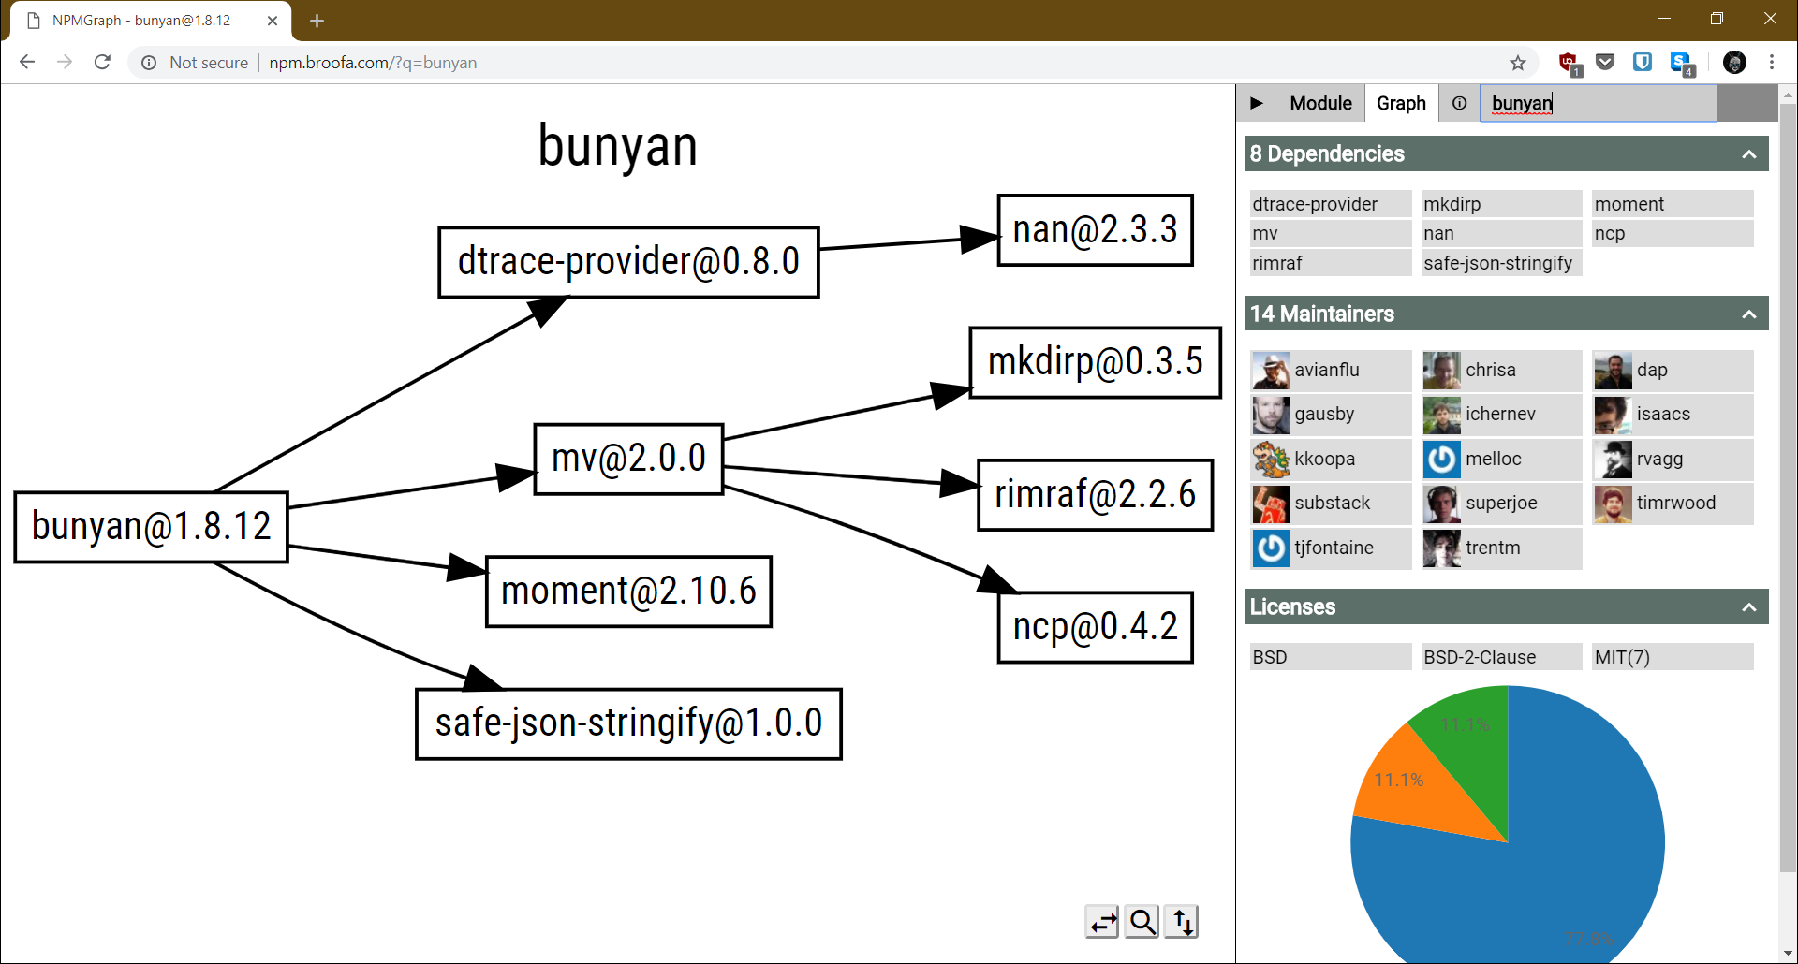
NPMGraph
Notes:
Bunyan is a logging framework with few dependencies of its own; still, it relies on 4 direct dependencies of its own, which in turn add another 4 transitive dependencies

Slide 18
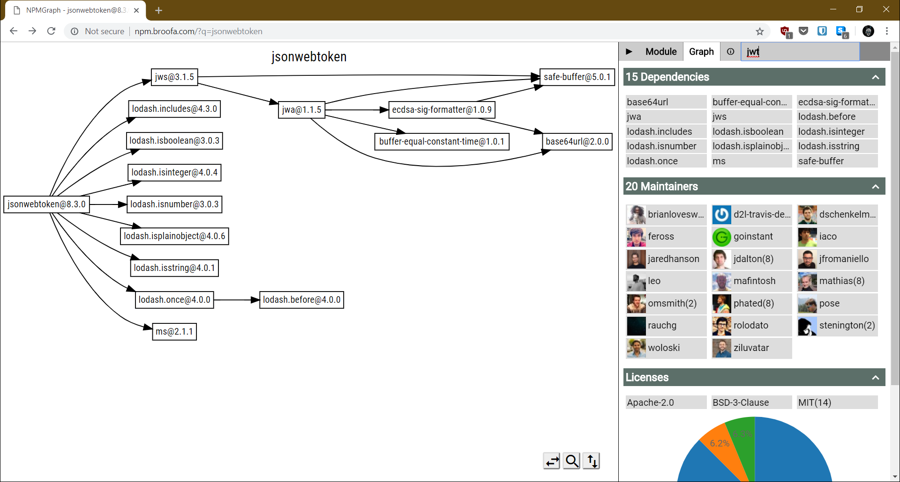
NPMGraph
Notes:
Jsonwebtoken is a more complex library and has a larger number of direct dependencies; our dependency resolution tree is now deeper and has multiple paths to some of the nodes, like safe-buffer, which is required by 3 different transitive dependencies

Slide 19
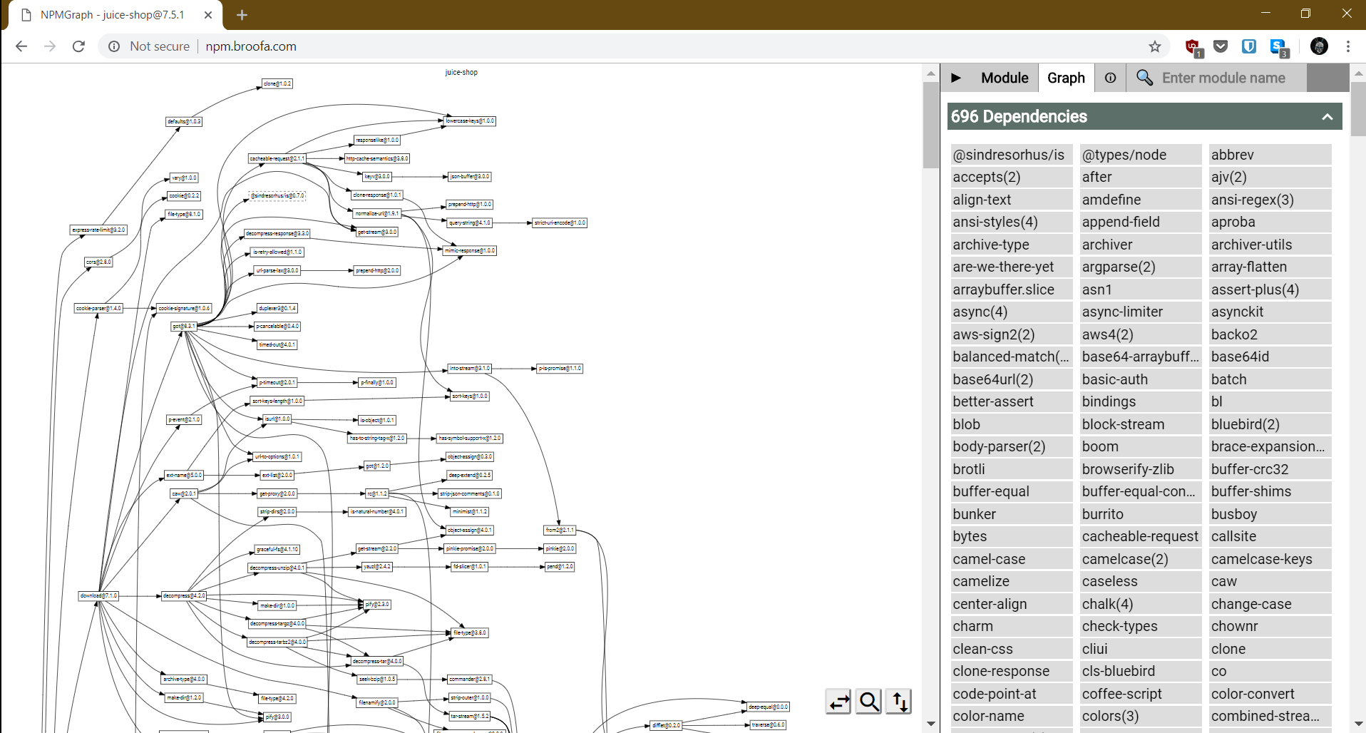
NPMGraph
Notes:
Explain the discrepancy in the numbers reported by npmgraph vs dependency check by explaining that it assumes the package is published in npm and fails to find metadata related to it

Slide 20
Transitive/Indirect Dependencies
Application manifest is not enough to determine full dependency resolution tree.
Software composition analysis tools need to leverage dependency resolution capability from the platforms they support.
Notes:
Software composition analysis needs to plug to dependency/package management solution used in build

Slide 21

snyk
Notes:
Snyk reports vulnerable dependencies AND vulnerable paths, because the same dependency might be introduced to our dependency resolution tree via multiple paths; this will affect our remediation, but we will get to that later in this presentation

Slide 22
Supported Languages and Build Tools
snyk.io
node.js
npm
Yarn
Ruby
Bundler
Java
Maven
Gradle
Python
pip
Scala
sbt
Go
dep
govendor
.NET
nuget
PHP
Composer
SourceClear
Java
Ruby
PHP
Maven
Gradle
Ant
Bundler
Javascript
npm
Bower
Yarn
Composer
Python
pip
Scala
sbt
Objective-C
Cocoa Pods
Go
go get
govendor
Godep
Glide
Trash
Notes:
These are all the languages and dependency management/build tools supported by snyk and sourceclear; because different dependency management platforms often have different backend systems and index dependencies in slightly incompatible ways, SCA must understand how to extract the relevant information – at the very least the library/package name and version – there is no such thing as “language support” by itself, it must be linked to a dependency management tool

Slide 23
Supported Languages and Build Tools
OWASP Dependency Check
Archive
Cmake
Java
zip
.NET Assemblies
tar
gzip
bzip2
exe
dll
CMakeList.txt
cmake
jar
War
Javascript
Package.json
Node Security Project
Nuspec
Nuspec
OpenSSL
opensslv.h
Ruby
Gemfile.lock
Notes:
OWASP Dependency Check is all over the place, but it mostly relies on finding files which match supported file extensions and attaches itself to that; it can also be executed via plugins to ant, Maven, Gradle and Jenkins

Slide 24
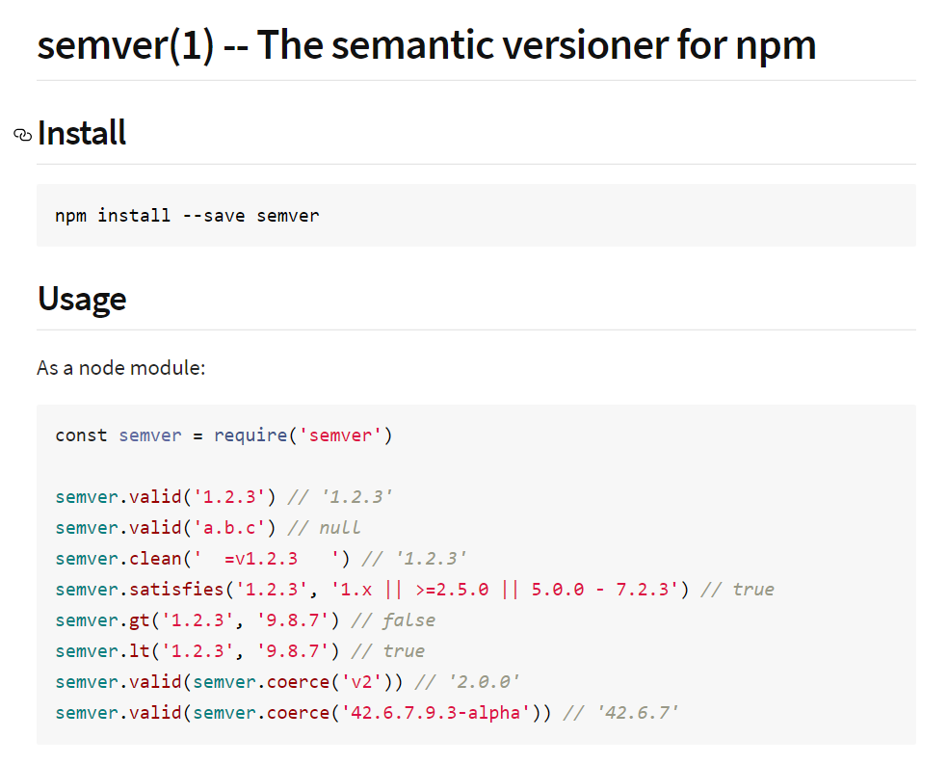
Semantic Versioning
Dependency versions might not be exact
Version ranges
Backwards compatibility
Wildcards
Notes:
Semantic versioning adds yet another dimension to the problem – instead of explicitly stating static versions in manifest files, developers can use ranges or wildcards, and the dependency resolution tool will try to find a version that meets the requirements at build time

Slide 25

Notes:
Our manifest specifies version 4.16.0 or anything else that’s backwards compatible with that; after npm install we get 4.16.4; because transitive dependencies might also be affect across versions of the direct dependency, we might end up with a completely different dependency tree depending on the version that actually got installed; npm BY DEFAULT will use semantic versioning when the developer does not provide a strict match criteria when adding a dependency

Slide 26

Temporal Build Dependency Resolution
Dependency version used will be the latest one that matches versioning restrictions
Different versions might have different transitive dependencies
Building the same software at different points in time might produce different dependency resolution trees!

Slide 27
Vulnerability Data Sources
NVD CVE Feeds
Vendor Advisories
Commit Log Analysis
Notes:
CVE feeds use CPE to match dependencies against known vulnerable versions; vendor advisories are more accurate but require massaging and collecting data from all involved parties; commit log analysis is done by Sourceclear and uses machine learning to parse commit log messages and help identify changes to open source library repositories which might indicate a security fix

Slide 28
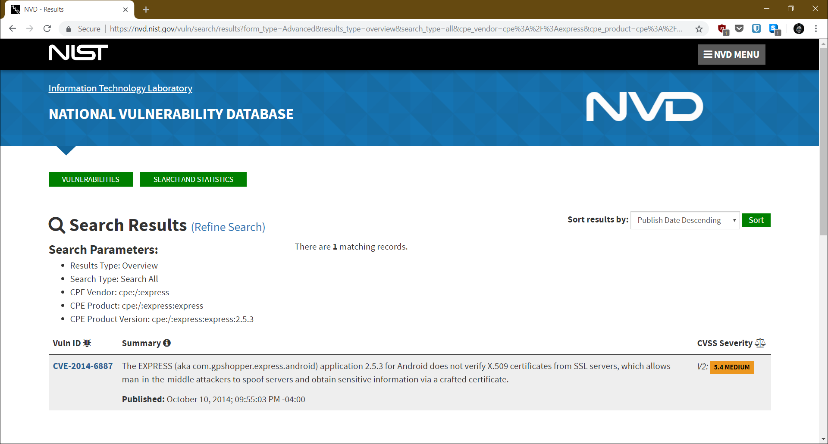
National Vulnerability Database
Notes:
CVE data is free and publicly available but often not very precise and unless the vendor has a nicely structured vulnerability reporting process, a security bug in their code might not produce a CVE

Slide 29
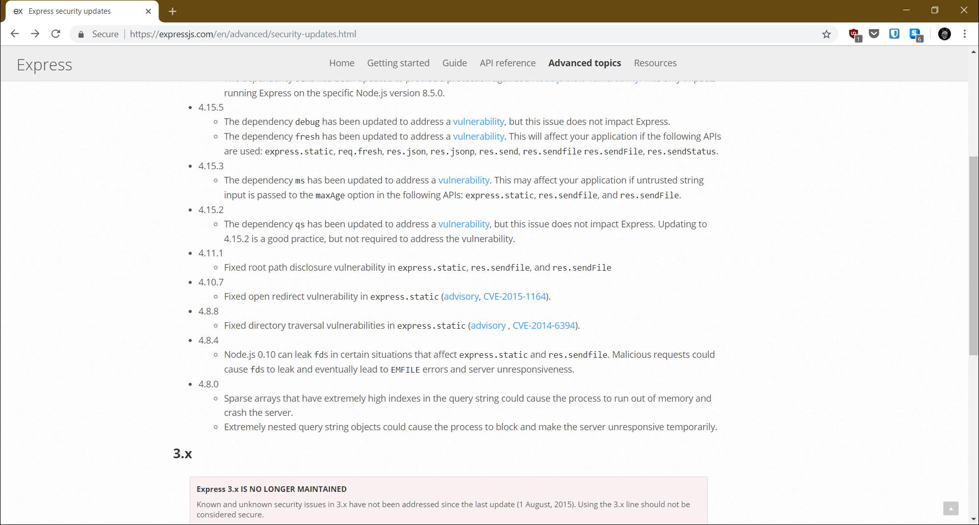
Express Security Updates
Notes:
At least 3 versions have vulnerabilities which do not seem to have CVEs linked to them; the ones that do have actually reference other packages – nodejs or serve-static

Slide 30

Commit Log Analysis
SourceClear claims they use machine learning over commit logs for libraries to identify security fixes and extract vulnerability information

Slide 31
Dependency Tree
Vulnerability Data Sources
Vulnerable Dependencies
Notes:
We match all the dependencies in the dependency tree against the vulnerability data sources; if a match is found, we know one of the nodes in our dependency resolution tree is vulnerable and we need to fix that

Slide 32
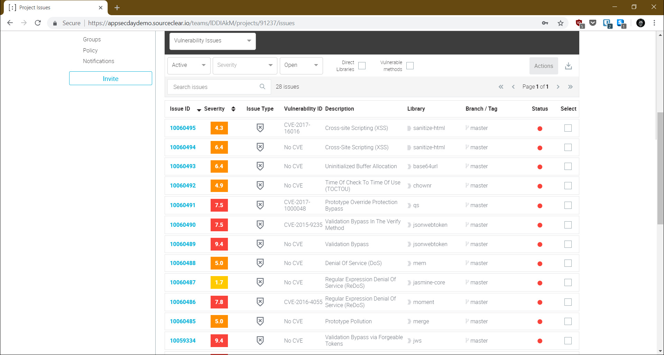
Notes:
Sourceclear dashboard showing all vulnerabilities for the OWASP Juice Shop project; notice that most of the reported vulnerabilities do not have CVEs associated with them and come from SourceClear proprietary’s vulnerability feeds which include vendor data and machine learning on commit log analysis; Sourceclear also has the unique feature of filtering results by direct dependencies (i.e., the ones we can remediate directly) and the libraries that have vulnerable code actually being called by the application (the “vulnerable methods” checkbox) – this means Sourceclear will do some static analysis of the code

Slide 33

Remediation
How do we remove vulnerable dependencies from software?

Slide 34

Notes:
Despite all the complexities mentioned in the previous slides, remediation is often surprisingly easy and fast – as long as the updated packages do not break functional requirements, but you should have unit and integration tests for that… right?

Slide 35
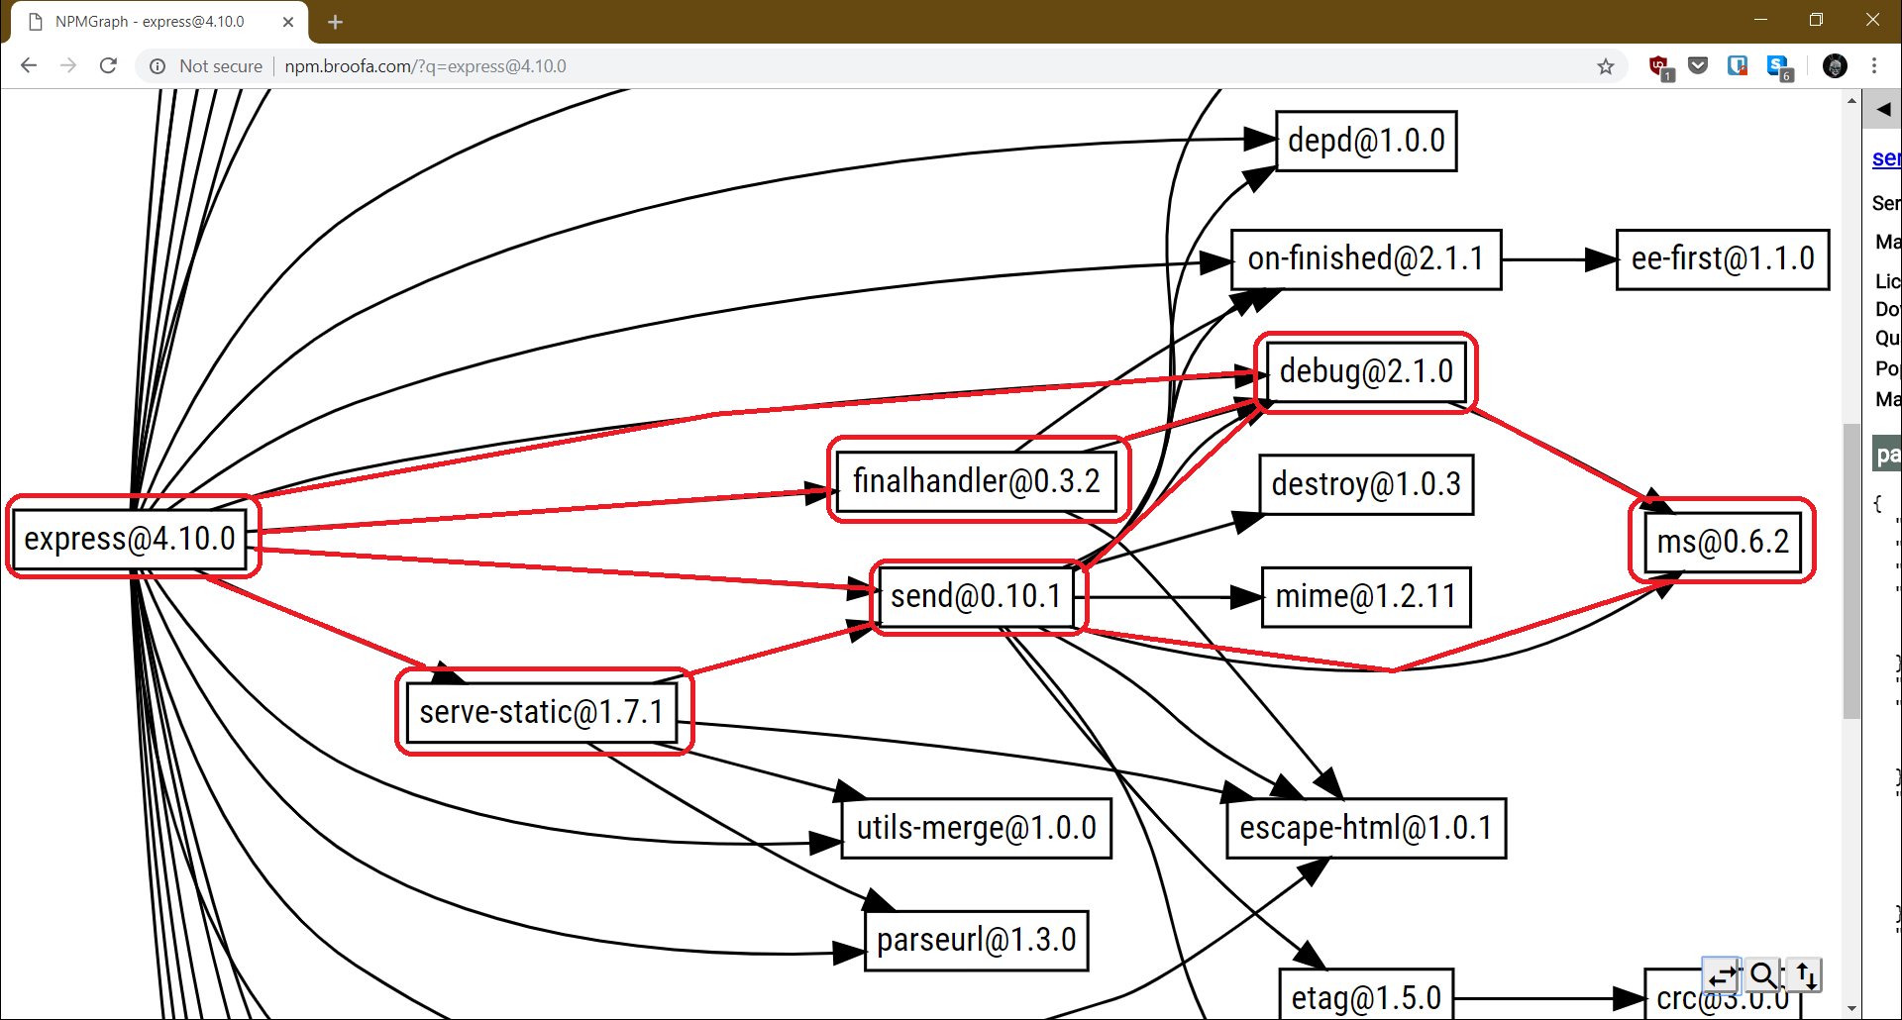
Remediation
Remediation effort is directly related to dependency resolution graph complexity
Number of paths leading to a vulnerable dependency
Versioning restrictions on transitive dependencies
Depth of vulnerable dependency
Notes:
ms@0.6.2 is vulnerable, and it can be reached from express@4.10.0 from 6 different paths – our ability to fix the issue depends on removing each of those 6 different injection paths; thankfully, express does a proper job of keeping itself free of vulnerable dependencies of its own, and we fix the problem by just upgrading express itself

Slide 36

Notes:
On a real world application with more dependencies changing one node might impact tens of other nodes, and remediation might introduce breaking changes; once again, if we have automated testing we might feel comfortable upgrading and checking if the later versions break functionality

Slide 37
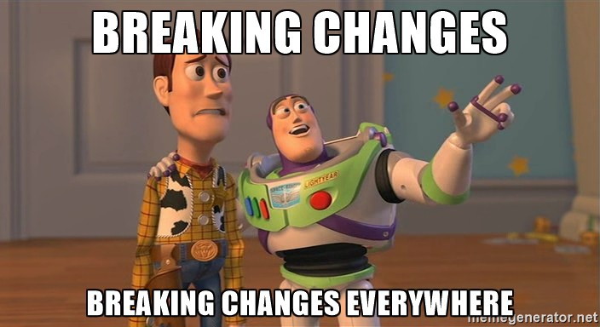
Remediation
Upgrades are often not possible
No later fixed version available
Dependency is introduced via multiple paths and only some offer upgrades
Upgrades break compatibility
Catch breaking API changes early

Slide 38
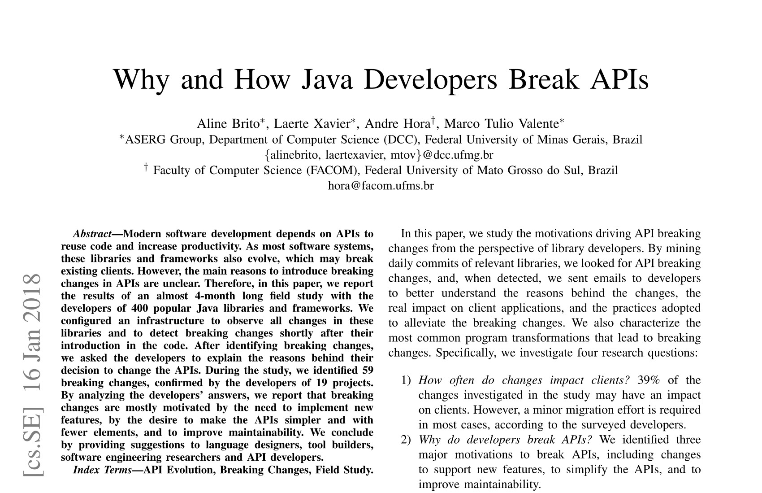
Why and How Java Developers Break APIs
Notes:
Not really a security-focused paper but provides some great insight on why developers break compatibility in their APIs in the Java ecosystem, which tends to be one of the most conservatives ecosystems; things move much faster in the dynamically typed language space (Ruby, Python, Javascript)

Slide 39
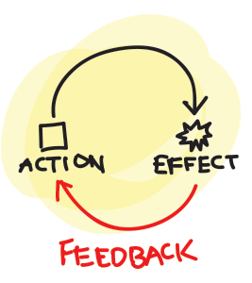
Remediation
When upgrade is not feasible…
Capture risk
Set deadline to re-evaluate
Never whitelist vulnerable dependencies unless application is being decommissioned
Notes:
Never blindly accept the risk linked to a vulnerable dependency; later vulnerabilities might be found in the same library, and what might seem like an acceptable risk today might not be tomorrow, particularly as we shift towards more iterative development models and the risk profile of applications change over time; aside from snyk, none of the existing SCA tools seem to do this properly…

Slide 40

Notes:
Snyk has the best workflow solution for this; it will by default only allow whitelist/risk acceptance for 30 days, and will start to return the same vulnerability again once that deadline is up; it will also ask for a reason

Slide 41
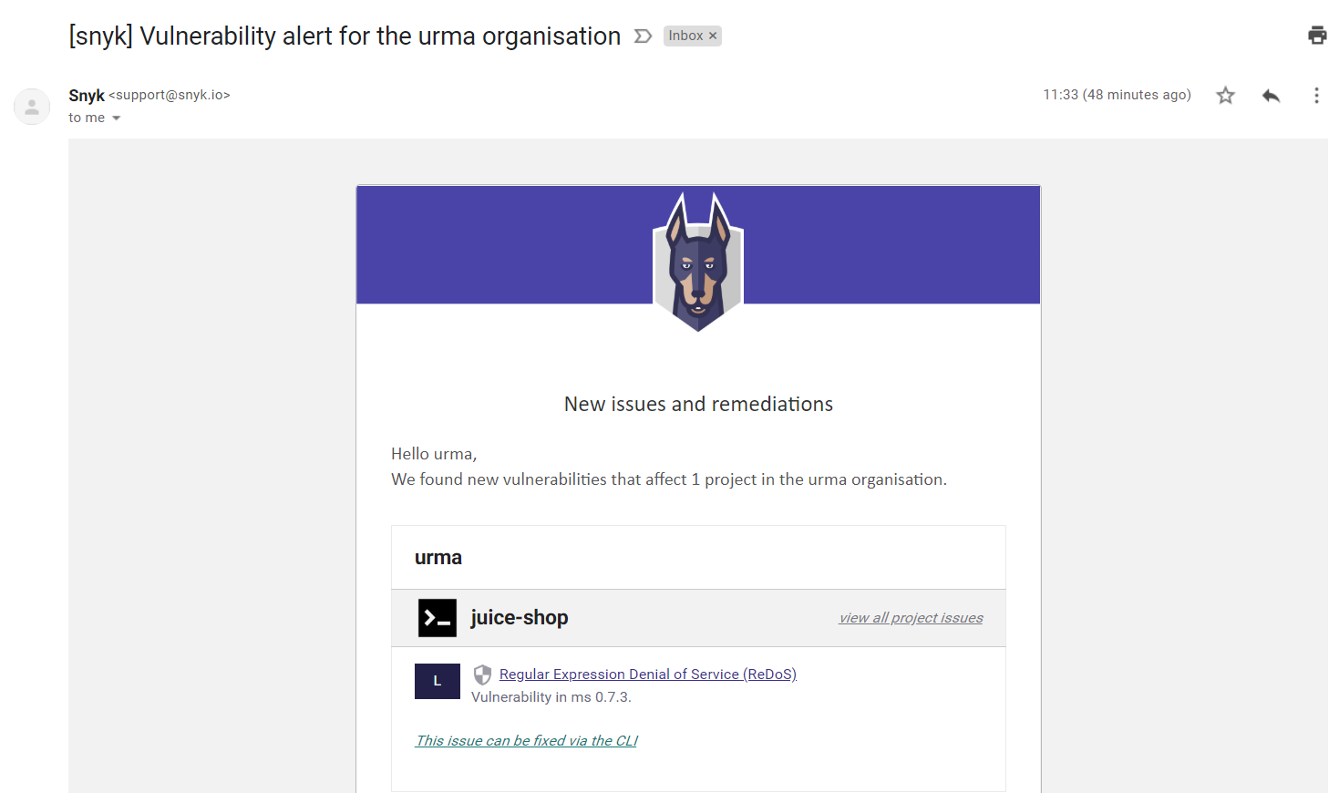
Notes:
Even better, if snyk finds out there is a fix for a vulnerable dependency it scanned in the past, it will proactively email the project owner and let them know they can now fix their software

Slide 42
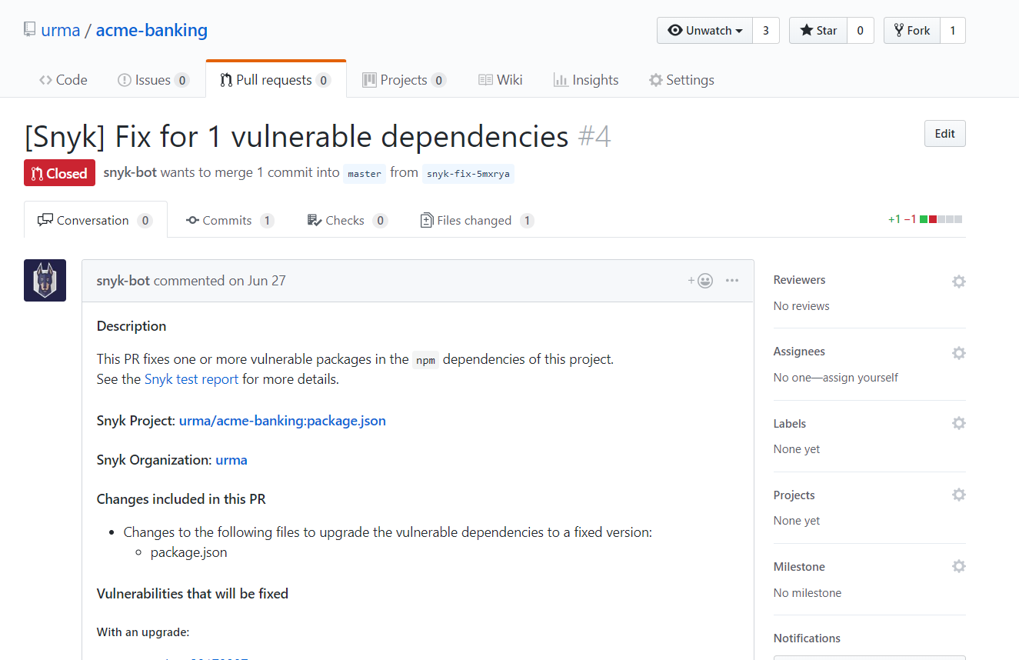
Notes:
Even better than that, if your project is open source, snyk will automatically create a pull request with fixes for your vulnerable dependencies

Slide 43

Maintenance
Ensuring existing software is free of vulnerable dependencies

Slide 44
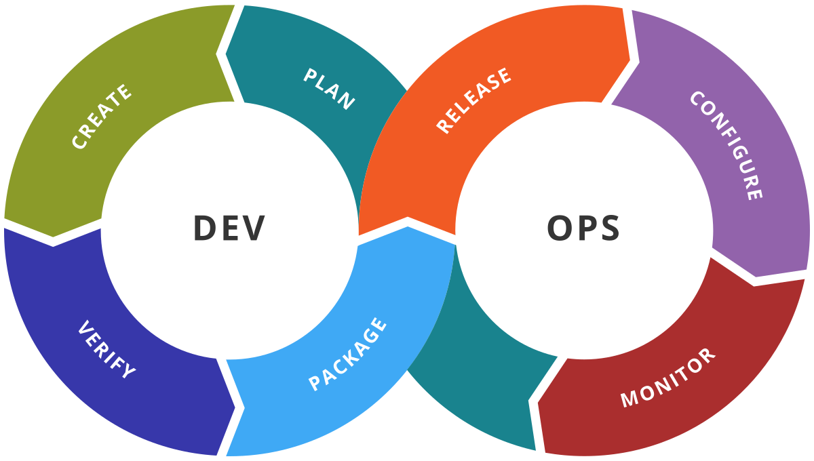
Maintenance
New vulnerabilities might be introduced via…
New or modified dependencies added to the application
New vulnerabilities found in previously clean dependencies
Notes:
Even after you’ve done all the work of ensure your software has no vulnerable dependencies, new ones might be found regardless of any changes you made to the application

Slide 45
Maintenance
Rebuilding your software periodically does not guarantee deployed versions are clean
Temporal build dependency resolution
Need to correlate SCA scan data, release tagging and deployment information
Dependency Resolution Tree
Vulnerability Data Sources
Deployed Versions and Archival Tags
Notes:
If we rebuild the software to find new vulnerabilities, we might end up with a different set of dependencies than the ones that are actually deployed, because semantic versioning means we get affected by temporal build dependency resolution; we need to constantly compare the manifest information we have for deployed versions of the application against updated vulnerability data source data

Slide 46
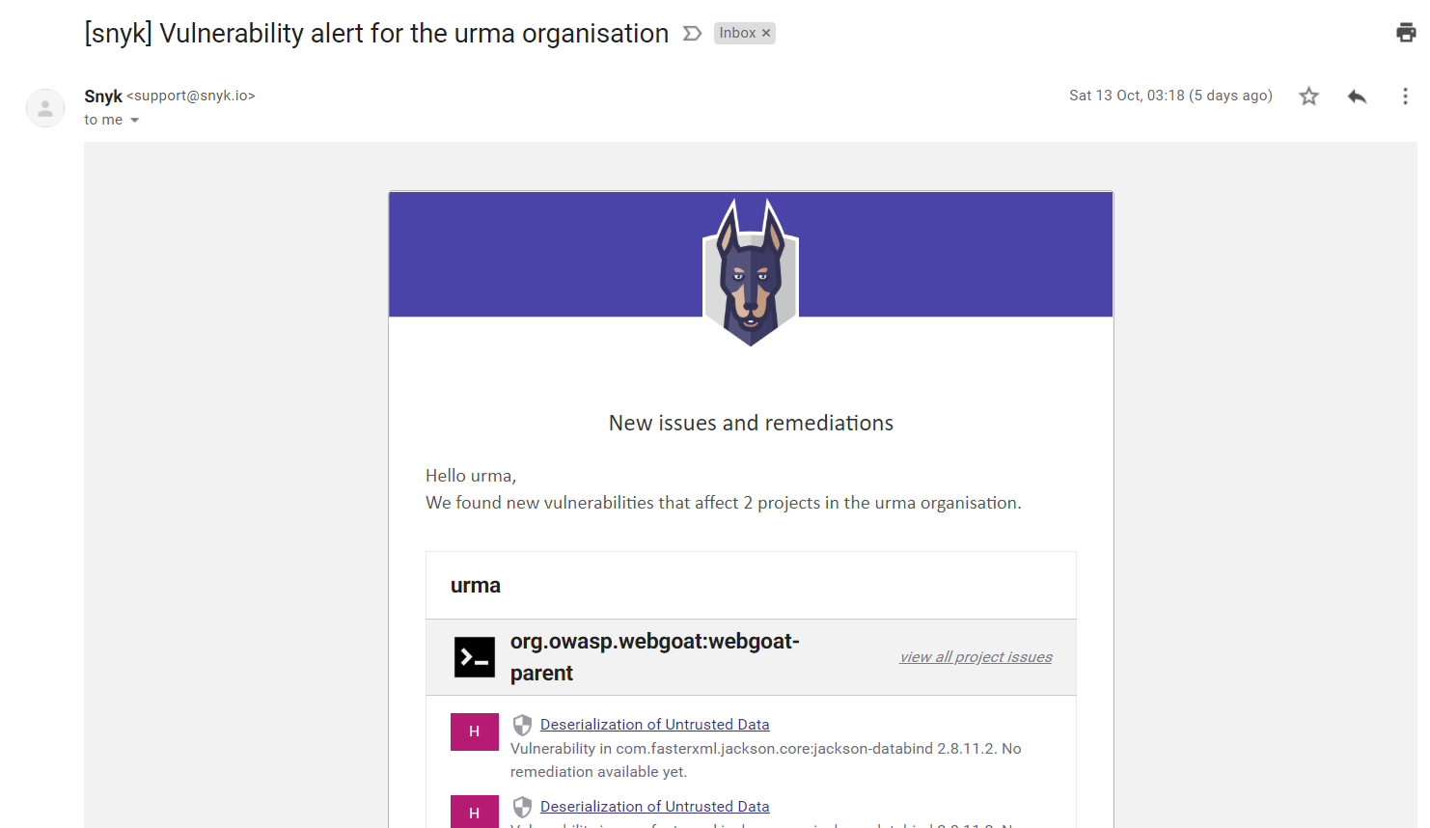
Notes:
If we are using SaaS offerings, they can do the heavy lifting for us – whenever a new vulnerability is found, they can retroactively revisit all of the scanned application data we have and tell us about it

Slide 47
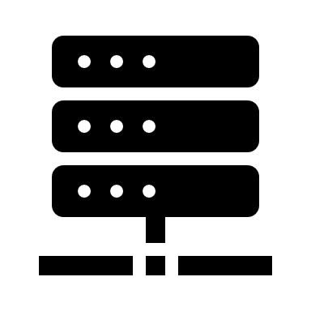
Artefact Registries
Restricting access to known vulnerable dependencies to avoid the problem

Slide 48
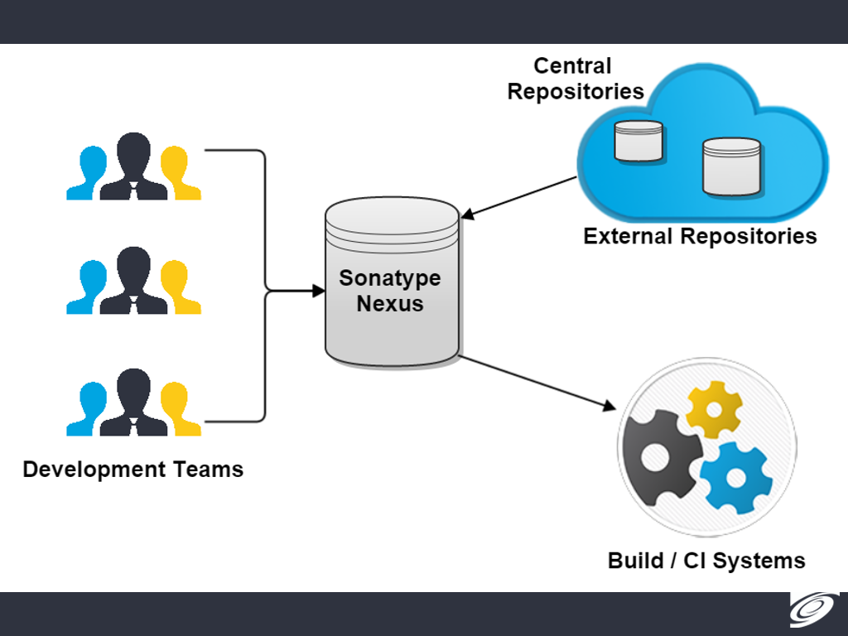
Artefact Registries
Act as middlemen between public registries and internal systems
Proxying/caching
Store private libraries and artefacts
Dependency blacklist
SCM-MANAGER UNIVERSE TOOLS PART 4: SONATYPE NEXUS
Notes:
Artefact registries can do a lot more than just filter content, and their capabilities in that space are rather limited without the support of plugins/components

Slide 49

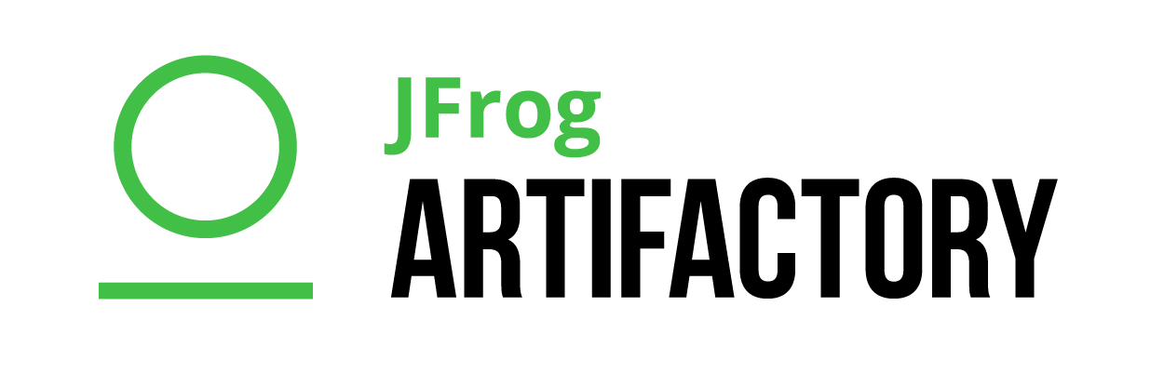
Key Players

Slide 50
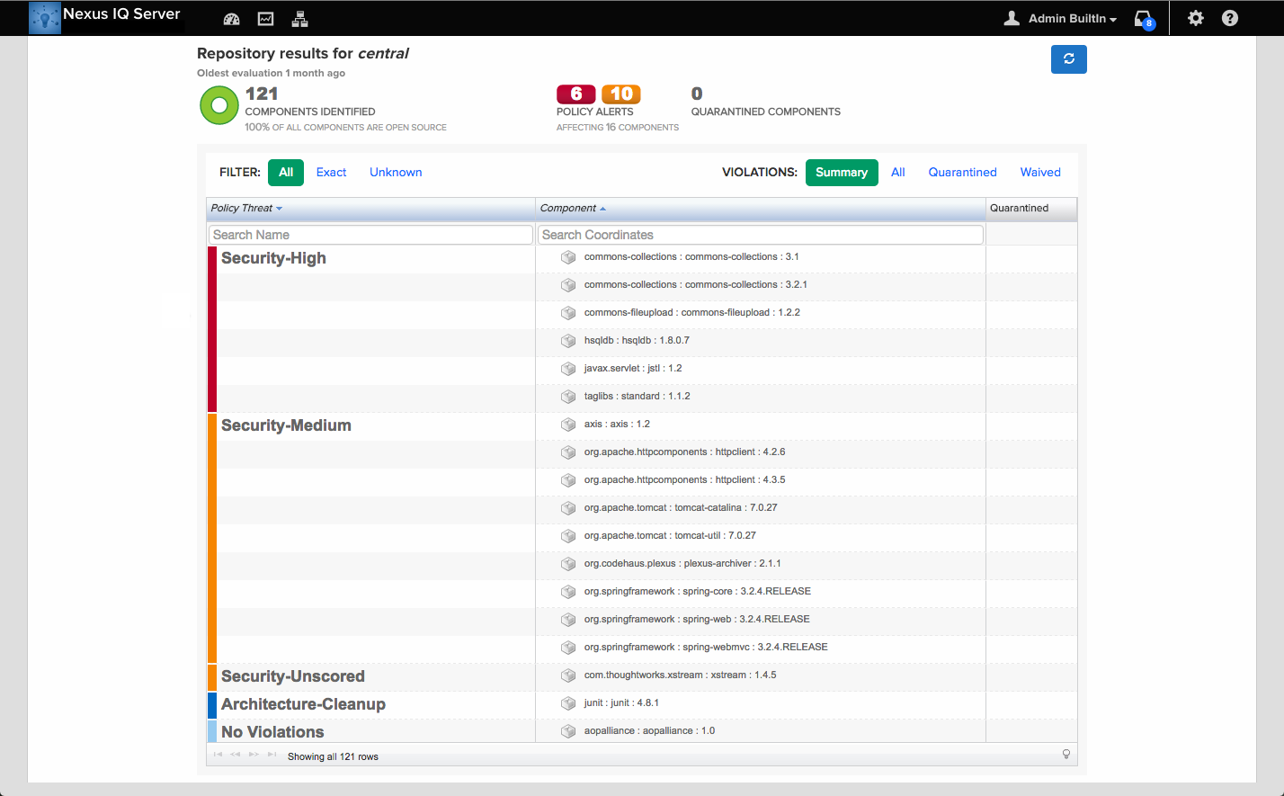
Notes:
Nexus Firewall can identify resources which sit in the registry and are known to be vulnerable, preventing them from being used in builds

Slide 51
Artefact Registries
Only effective when combined with network controls which restrict access to public repositories
Prevents builds which include known vulnerable components but gives less visibility to the actual vulnerabilities associated with them

Slide 52

Github Vulnerable Components Insight
Bonus: snyk ❤️ github

Slide 53
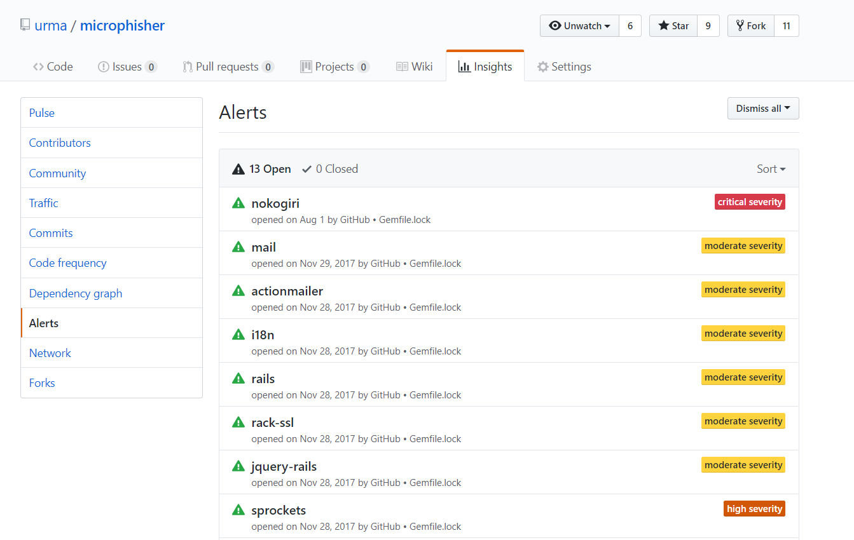

Slide 54
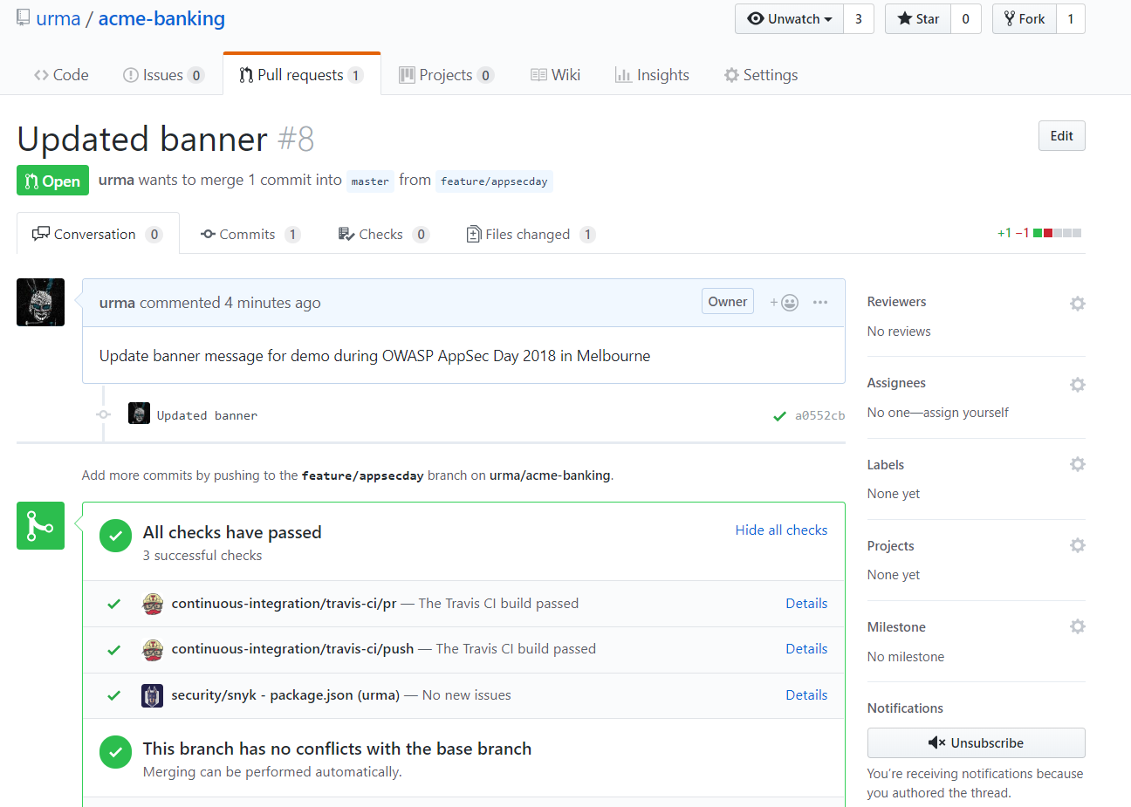

Slide 55
TL;DR
Dependencies – it’s not a list, it’s a rather complicated graph with multiple paths leading to vulnerable components
Remediation cost depends on graph complexity, not just on number of vulnerable components
You’ll often not be able to fix immediately, but that does not mean you should whitelist vulnerable components indefinitely
New vulnerabilities in components will pop up even if you make no changes to the application code
No best-of-breed yet – all products lacking in some aspect

Slide 56



Don’t be a stranger!
ulissesalbuquerque
@urma
ulisses dot montenegro at gmail

